Slide 1
The A.I. Vending Machine
Members: Dante Gordon, Devan Rivera, Bryan Oxender, and Darrell Wilson II
Speaker: Devan

Slide 2
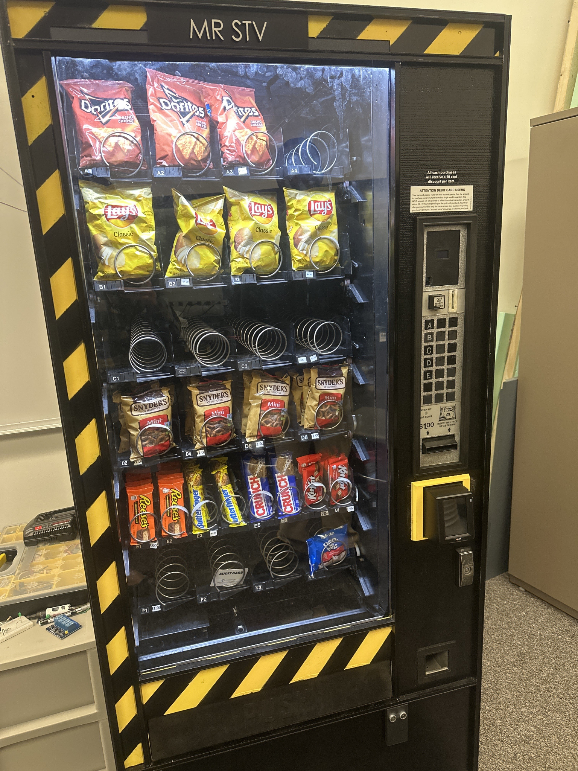
Introducing MR STV
M - Machine
R - Raspberry PI
S - Snack
T - Talking
V - Vendor
Speaker: Devan
Figure 1. MR STV’s Final Design

Slide 3
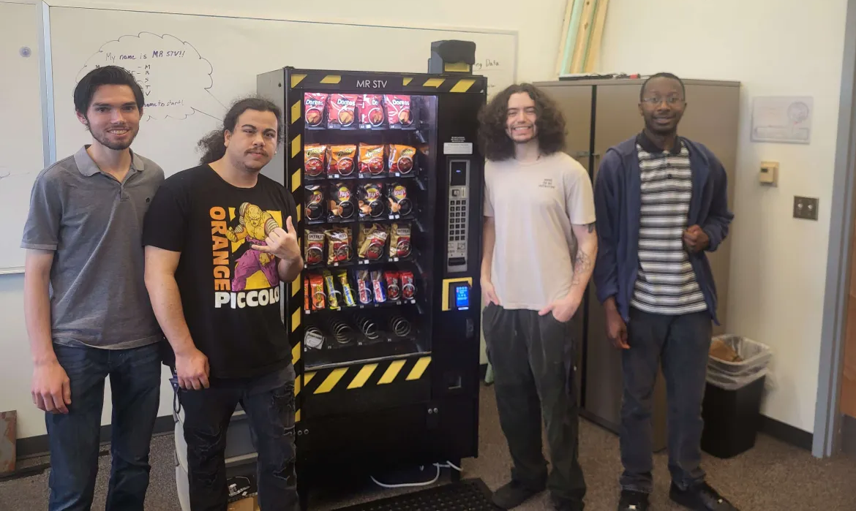
Deliverables
Full size functioning prototype
Full interaction using voice recognition
Capable of accepting cash or cashless payment
Functional as a standard vending machine
Figure 2. MR STV and Team Members
Speaker: Bryan

Slide 4
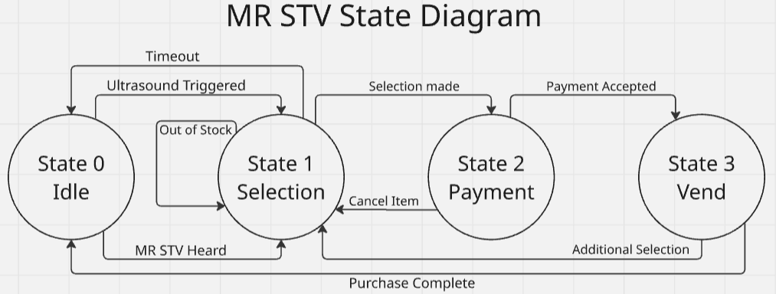
Project Summary
Utilizes machine learning to transcribe audio
Accessible to the visually impaired
Functional as a standard vending machine
Communication to peripherals handled by MDB/ICP
Raspberry PI 5 VMC
Arduino Mega 2560 Motor Control
Figure 3. MR STV’s State Diagram
Speaker: Devan

Slide 5
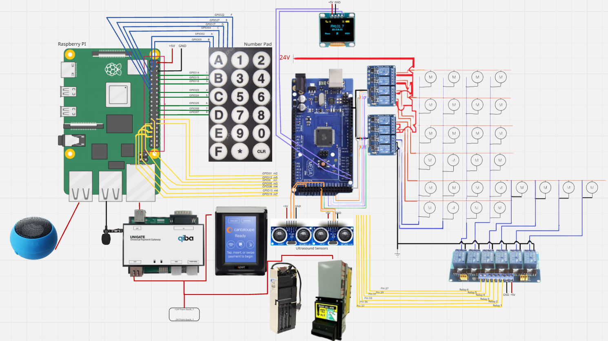
Pin Diagram
Raspberry PI VMC
Keypad Interrupts
Microphone
Speaker
MDB Communication to peripheral devices
Communication to motors
Arduino
Motor Control
OLED Screen
Ultrasound Sensors
Figure 4. Finalized Pin Diagram with all Peripherals
Speaker: Devan

Slide 6
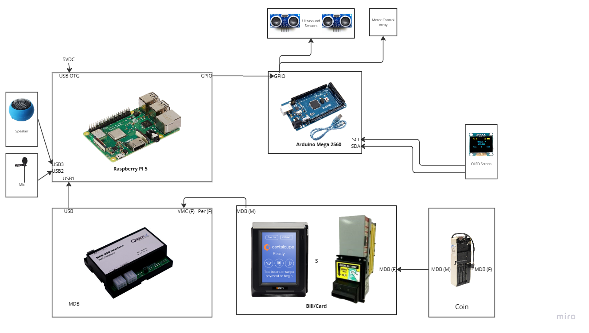
Final System Block Diagram
Figure 5. System Block Diagram
Speaker: Dante

Slide 7
Difficulties Faced
Response Latency
Transcription Accuracy
Button Design
Card Reader
Operating System Requirements
Gathering Volunteers
Power Supply
Audio Resampling
Speaker: Bryan

Slide 8



Preliminary Testing:
Raspberry PI Controller
OS
GPIO
SSH
MDB Communications
ICP
C++ Program
API
Latency
Figure 6. Companies Used
Speaker: Dante

Slide 9
Human Testing Results:
Quantitative data such as time to receive selection
Average run time was ~1:20
Qualitative data such as issues and conveniences encountered when using our application
Most individuals faced little issue with the audio interface
On occasion transcription would capture an incorrect phrase
Test Cases for Individuals who interacted with Vending Machine
Utilized a Blindfold
Ultrasound Activation
Cash/Cashless Payment
Received Product
Speaker: Dante

Slide 10
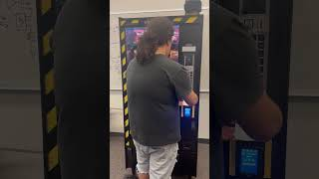
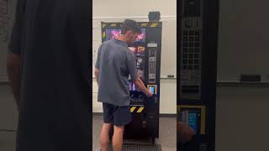
A Successful Result!
Voiceless Vendor/Standard Mode
MR STV/Visual Impairment Mode
https://youtube.com/shorts/TMZv5TdMpUQ?si=B8r4iJhijPjDJ4BR
https://youtube.com/shorts/bwTJZ-OhBNc?si=Hpv6INX3LIn4zTbS
Speaker: Darrell

Slide 11
Final Budget
Components | Price | Quantity | Description
Ultrasonic sensors | $3.95 | 2 | Ultrasonic sensors can be used with microcontroller to sense an object a certain distance away these ones have a range of 2-450cm.
Engage Cantaloupe card reader +telemetry | $375.15 | 1 | Payment Peripheral capable of card payment.
Cashless service | $9.99 (per-month) | 3 | Service utilized for processing and receiving cashless payments.
MEI CPI VN25P2 | $254.72 | 1 | Payment Peripheral capable of accepting bills.
Buck Converters | $7.99 | 1(5-pack) | Converters reduce higher input voltage to a lower output voltage while increasing current.
Anti-Fatigue Floor Mat | $39.99 | 1 | Water-resistant commercial grade rubber mat
Speaker: Darrell
Notes:
Power supply, raspberry pi upgrade, toolchest were expensive

Slide 12
Components | Price | Quantity | Description
Coin Changer Acceptor Mars VN4510 | $183.38 | 1 | MDB coin acceptor
Qiba MDB USB Standard | $231.54 | 1 | MDB qiba converter to USB interface
JOUNIVO USB | $16.99 | 1 | 360 Degree Position Adjustable Gooseneck Design
USB Microphone Lavalier | $11.99 | 1 | USB plug and play Lavalier Mic for PC and Mac
5V 5A USB Type C | $12.99 | 1 | Charger for the Raspberry Pi 5
Speaker: Darrell

Slide 13
Components | Price | Quantity | Description
Qiba MDB Toolchest License | $425.71 | 1 | Software used to simulate vmc and read the mdb databus was used for testing and debugging.
Mini USB External Speaker | $12.50 | 1 | Speaker for the A.I. Vending machine.
Raspberry PI 5 | $50.00 | 1 | 4 RAM Raspberry Pi 5
150μF capacitor | $2.60 | 3 | Device that stores electrical energy
1N4002 rectifier diodes | $0.78 | 6 | Signal Diodes
25W Power Supply | $19.88 | 1 | Power supply for the Vending Machine and Raspberry Pi
Total Cost (current) | $1869.89
Projected Cost: $1,322.37
Difference: -$547.52
Speaker: Darrell

Slide 14
Conclusions
Effective Accessibility Improvements for the Visually Impaired
Practicing Ethical and Safety Standards throughout the Project
Applied electrical engineering skills such as rectification, voltage conditioning and circuit protection
Understanding Software/Hardware Integration
Audio Processing, and Artificial Intelligence
Developing Control Systems with Microprocessors Communication and I/O Interaction
Speaker: Everyone

Slide 15
THE END!
Thank you for your time!
Any questions?
Speaker: Everyone

